Slide 1

The GIC July 2020:
Plan and rate information for assistance in choosing the “”Right Plan for You”
Spring 2020

Slide 2
Today’s Agenda
Overview
GIC Medical Plans for Active Employees, Non-Medicare Retirees, & Medicare Retirees
GIC Annual Deductibles
GIC Provider Tiering & Copays
Tips for Selecting Your GIC Plan
The FY21 Benefit Decision Guide (BDG) should be referenced when considering any changes - attached

Slide 3
Overview
Town employees, retirees and survivors will continue to receive their health insurance through the GIC
Open enrollment starts April 6 and is now extended until June1st as a result of the Corona Virus and to allow staff to meet the GIC’s Deadline
Changes in plan selection or enrollment need to be provided to Treasurer’s office by noon on June 1st
Members have an opportunity to attend a GIC benefits fair – see next page for schedule and locations, carrier representatives will be available to assist our members as necessary

Slide 5
FY21
GIC Health Care Plan Changes effective July 1, 2020
Health Benefit Changes / Improvements made to UniCare plans (Base, Plus, and CC)
  Reduced or eliminated co-pays, deductibles and co-insurance for behavioral health parity with other plans
No other changes included for remaining plans – reminder though, provider tiers change each July 1st.
Premium Cost Increases: East Bridgewater Average = 4.74%
  Final to be based on actual enrollments after open enrollment/educational meetings!
  Regional Plans: 4.1% to 6.7% (HNE & Allways Health Partners)
  Limited Plans: 3% to 7.6% (UniCare CC, Tufts Spirit, Fallon Direct, HPHC Primary Choice)
  Broad Plans: 3% to 7.1% (UniCare Plus, Tufts Navigator, Fallon Select, HPHC Independence)
  National Plans: 7% to 7.3% (UniCare Basic w/o CIC, UniCare Basic w/CIC)
  Medicare Plans: .8% to 3.3% TMP, TMC, UniCare Ind OME w/CIC, HPHC Enh, HNE Med Sup)

Slide 6
The GIC’s Medical Plans
The GIC offers 12 plans for Active Employees and Non-Medicare Eligible Retirees & Survivors
  2 Indemnity Plans – National Network
  2 PPO –Type Plans – Improved benefits with local network provider
  2 POS Plans – Broad network access, referred in network provides better benefits
  1 Broad Network HMO Plan –Broad network access,
  5 Limited Network HMO Plans
GIC plans have geographic limitations
  Consult the map on p.5 of the Benefit Decision Guide for Active Employee and Non Medicare Retirees
  Consult the map on p. 9 of the Benefit Decision Guide for Medicare Retirees

Slide 7
Which GIC plans are the Town’s 245 employees and 51 Non-Medicare retirees covered under today?

Slide 8
The GIC’s Medical Plans – How they compare!
Category | Indemnity | PPO -Type Preferred Provider Organization Plan | POS Point of Service Plan | HMO Health Maintenance Organization Plan
Provider Choice | Highest | High | High | Moderate To Limited
PCP Required | No | No | Yes | Yes
Referral Process | Not Required | Not Required | Required | Required
Your Cost | Highest | Lower | Higher | Lowest

Slide 9
GIC – Full Town and subscriber premium rate

Slide 10
GIC – Active & Non-Medicare Retiree: Town of East Bridgewater – Your Monthly Contribution Splits for Ind or Fam Coverage
6 Plans are offered at 70% Town and 30% member cost - annual
Plan | Your cost for individual coverage | Your cost for family coverage
Health New England | $2139 | $5093
Tufts Spirit | $2184 | $5261
Fallon Direct Care | $2227 | $5621
Harvard Pilgrim Primary Choice | $2396 | $6109
Allways Health Partners | $2476 | $6442
Fallon Select Care | $3010 | $7319
See page 2 of the BDG for more open enrollment checklist information!
Page 15 of the BDG has carrier network web site information for provider look up.

Slide 11
GIC – Active & Non-Medicare Retiree: Town of East Bridgewater – Your Monthly Contribution Splits for Ind or Fam Coverage
4 Plans are offered at 60% Town and 40% member cost - annual
Plan | Your cost for individual coverage | Your cost for family coverage
UniCare State Indemnity Community Choice | $2652 | $6567
UniCare State Indemnity Plus | $3474 | $8268
Tufts Navigator | $3836 | $9367
Harvard Pilgrim Independence | $4402 | $10,748
See page 2 of the BDG for more open enrollment checklist information!
Page 15 of the BDG has carrier network web site information for provider look up.

Slide 12
GIC – Active & Non-Medicare Retiree: Town of East Bridgewater – Your Monthly Contribution Splits for Ind or Fam Coverage
2 Plans are offered at 50% Town and 50% member cost - annual
Plan | Your cost for individual coverage | Your cost for family coverage
UniCare State Indemnity Plan Basic with Comprehensive Insurance Coverage | $6983 | $15,496
UniCare State Indemnity Plan Basic without Comprehensive Insurance Coverage | Given extra cost sharing required with this program, no current enrollees
See page 2 of the BDG for more open enrollment checklist information!
Page 5 of the BDG for out of network access if needed.

Slide 13
Which plans are the current 225 Medicare subscribers covered under today?

Slide 14
GIC – Medicare Retiree: Town of East Bridgewater – Your Monthly Contribution Split
5 Plans are offered at 70% Town and 30% member cost - annual
Plan | Your cost for individual coverage
Tufts Medicare Preferred | $1170
Tufts Medicare Compliment | $1382
UniCare Sate Indemnity Plan OME | $1444
Harvard Pilgrim Enhance | $1454
Health New England Medicare Plus | $1454
See page 2 of the BDG for more open enrollment checklist information!
See page 9 of the BDG for geographic resident requirements – TMP is available to specific counties only!

Slide 15
GIC Limited Network HMO Plans (5 choices)
Fallon Community Health Plan Direct Care
Harvard Pilgrim Primary Choice
Health New England
Allways Health Partners
Tufts Health Plan Spirit
Members must select a Primary Care Physician (PCP)
Referrals are required to see Specialists
No coverage for out-of-network providers, except for emergencies
Member must reside in network service area to enroll
Lowest premium costs
Limited provider networks

Slide 16
GIC Broad Network HMO Plan (1 choice)
Fallon Community Health Plan Select HMO
Members must select a Primary Care Physician (PCP)
Referrals are required to see Specialists
No coverage for out-of-network providers except in emergencies
Member must reside in network service area to enroll
Lower premium cost than Indemnity, PPO or POS plans, but higher costs than the Limited Network HMO Plans

Slide 17
GIC PPO-Type Plans (2 choices)
UniCare Community Choice
UniCare Plus
In-network and out-of-network benefits; use any provider
  In-network providers - lower out-of-pocket costs
  Out-of-network providers - higher out-of-pocket costs
UniCare Plus has a much larger provider network
No requirement to select Primary Care Physician (PCP)
No referrals required for specialists
Member must reside in network service area to enroll

Slide 18
GIC POS Plans (2 choices)
Harvard Independence POS
Tufts Navigator POS
Members must select Primary Care Physician (PCP)
Referrals required for specialists
In-network and out-of-network benefits
  In-network providers - lower out-of-pocket costs
  Out-of-network providers - higher out-of-pocket costs
Member must reside in network service area to enroll

Slide 19
GIC Indemnity Plan (2 Choices)
UniCare Indemnity Basic with CIC Rider
Members not required to select a Primary Care Physician (PCP)
  Members can utilize any provider
  No referrals required for specialists
No geographical restrictions on enrollment
Only option for persons living permanently outside New England (early retirees)
Highest premium cost
Elimination of CIC available as 2nd plan option

Slide 20
All Non-Medicare Plans Include Deductibles For Certain Medical Care Services
  A Deductible is a fixed amount a member pays before the plan pays benefits. Most GIC plans have the same deductibles.
  The deductible generally does NOT apply to:
    Prescription drug benefits
    Outpatient mental health/substance abuse benefits
    Office visits (primary care physician, specialist, retail clinics, maternity & well baby care, routine eye exam, occupational therapy, physical therapy, chiropractic care & speech therapy)
    Medically necessary child & adult immunizations
    Hearing aids
    Mammograms & Pap smears
    EKGs
    HNE, UniCare CC, Tufts Sp, Fallon DC, HPHC PC all have lower deductibles

Slide 21
Reminder
  The Deductible DOES apply to:
    Emergency room visits
    Inpatient hospitalization
    Surgery
    Laboratory and blood tests
    X-rays and radiology (including high-tech imaging, such as MRI, CT, and PET scans)
    Durable medical equipment

Slide 22
Deductibles – apply to Active and Non-Medicare plans only
Election Status | Amount for: UniCare Indemnity UniCare Plus THP Navigator Fallon Select Care HPHC Independence Allways Health Partners | Amount for: HNE UniCare Com. Choice THP Spirit Fallon Direct Care HPHC Primary Choice
Individual | $500 | $400
Family | $1000 | $800
Please see pages 6 and 7 of the BDG for further information.

Slide 23
Tiered Provider Copays – apply to Active and Non-Medicare plans only
  Specialists & Hospitals are grouped into “tiers” based on cost & quality
    Each carrier tiers differently
    Tier 1 Providers have lowest member cost & Tier 3 Providers have the highest member cost
    Certain plans have lower in-patient co-pays
  When you have an inpatient admission you must pay your deductible first and then you pay the hospital copay

Slide 24
Non-participating Hospitals – Active and Non-Medicare plans
All indemnity plans and most broad network plans cover most Massachusetts hospital facilities
  UniCare, Tufts Navigator, HPH Independence, and Fallon Select Care
Most Regional and Limited Network Plans include non-participating hospitals in their network.
Members are encouraged to check the carrier web sites – BDG page 15 for more detailed information
Examples:
  Fallon Select Care does exclude Cape Cod, Nantucket, Falmouth, and Martha’s’ Vineyard Hospitals
  Mass General is excluded from Health New England, HPHC Primary Choice, THP Spirit, UniCare CC, but may be covered under Fallon Directs Piece Of Mind Program
The GIC Master Hospital List is included with this information for use when considering which plan option is best suitable for you and your family.

Slide 25
Tips for Selecting a GIC Plan
Talk to your PCP
  Will your POS-plan PCP refer you to the specialist you want to see?
  Don’t say “Do you take Harvard Pilgrim” for example.
  Do say “Do you take the GIC Harvard Pilgrim Independence POS Plan?”
Contact the carriers on the telephone or online. Ask about:
  physicians,
  hospitals,
  drugs & durable medical equipment
  (see Guide, p. 15, for contact information)
Attend a GIC Health Fair (see Guide, p. 14, for Health Fair schedule)

Slide 26
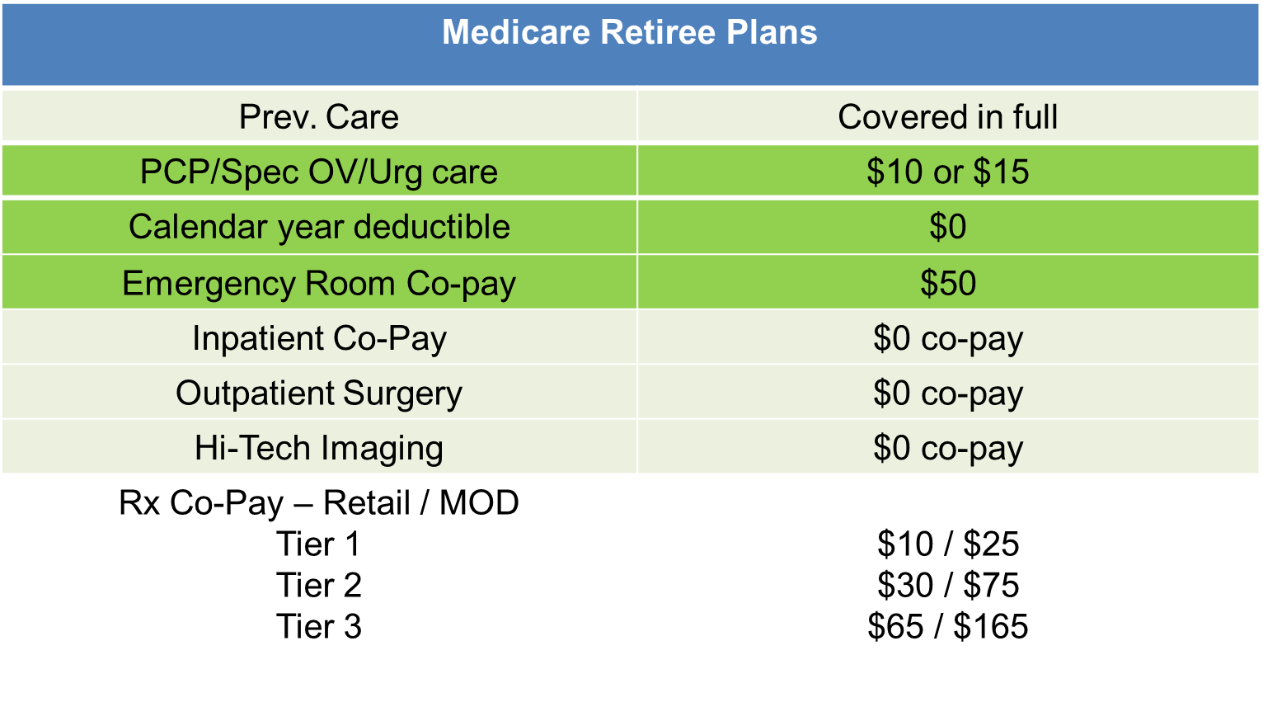
Medicare Retirees – There are no changes for July 2020, summary plan of benefits reminder:
See page 10 of the BDG for more information!

Slide 27
Important Reminders
Annual enrollment is your once-a-year opportunity to change your health plan or coverage election.
You may make certain changes to your elections within 60 days of a qualifying event. Qualifying events include marriage, birth/adoption, involuntary loss of other coverage, spouse’s Annual Enrollment or return from an approved FMLA or military leave. Your doctor or hospital leaving a network is not a qualifying event. For complete details, go to bit.ly/giclifeevents.
New hires must enroll in coverage within the first 10 days of employment.
Doctors and hospitals within your network may change during the year. If your doctor is no longer available, your health insurance carrier will help you find a new one.
When checking provider coverage and tiers, specify the health insurance product’s full name, such as “Tufts Health Plan Spirit” or “Tufts Health Plan Navigator,” and not just “Tufts Health Plan.” Your health insurance carrier is the best source for this information.
Do not enroll in a non-GIC Medicare Part D product. All GIC Medicare plans include Medicare Part D coverage. If you enroll in another Part D product, the Centers for Medicare and Medicaid Services will disenroll you from your GIC coverage. This means that you will lose your GIC health, behavioral health and prescription drug benefits.

Slide 28

www.NFP.com

